Slide 1
Online Edu. Employment (Android)
Project Plan
VEL team
14 Aug. 2015

Slide 2
Project Plan
Agenda
1. Team VEL
2. Product Owner
3. Project Goal & Major Capability
4. Product Backlog
5. Development Plan
6. Scrum PM Tool
7. One User Story
8. Risk Management

Slide 3
1. Team VEL

Slide 4
2. Product Owner

Slide 5
3. Project Goal and Major Capability

Slide 6
4. Product Backlog

Slide 7
5. Development Plan

Slide 8
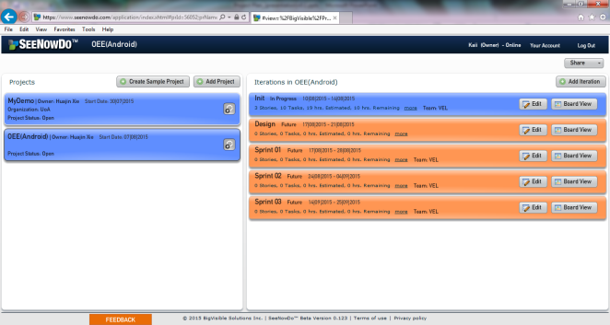
6. Scrum PM Tool (1)
SeeNowDo
URL: https://www.seenowdo.com/pages/login/index.html
Project Name: OEE(Android)
Image of project list & iteration list

Slide 9
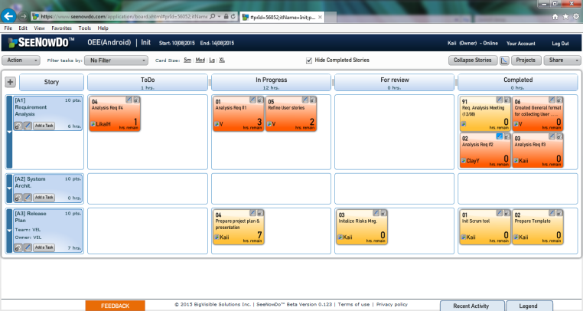
6. Scrum PM Tool (2)
SeeNowDo
Image of User Stories and Tasks List of one sprint

Slide 10
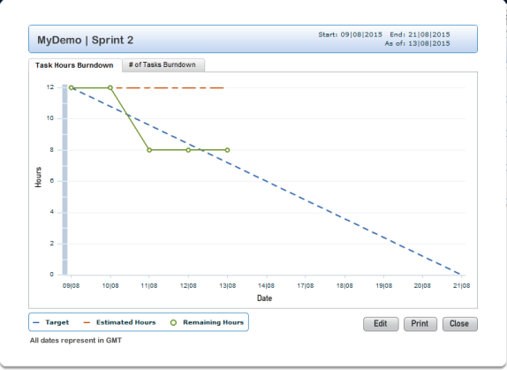
6. Scrum PM Tool (3)
SeeNowDo
Image of Burn-Down Chart

Slide 11
7. One User Story (1)
User story #1
As visitor, when I use mobile devices (phones and pads) to access the website, I want to see that the framework (the header, footer and buttons) of this website is suitable for my using behavior on mobile devices
So that I can use this website on mobile devices as convenient as on PCs.

Slide 12
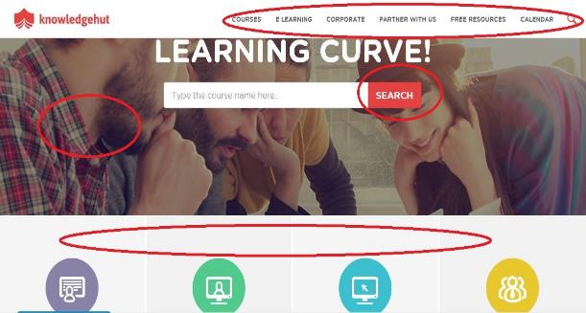
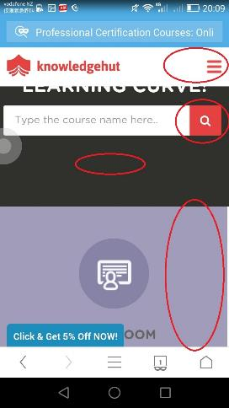
7. One User Story (2)
The menu, button, picture and layout may change from PC to phones.

Slide 13
7. One User Story (3)
User story #1
As visitor, when I use mobile devices (phones and pads) to access the website, I want to see that the framework (the header, footer and buttons) of this website is suitable for my using behavior on mobile devices
So that I can use this website on mobile devices as convenient as on PCs.
Device type detection
DPI & resolution detection
Dynamically changing style

Slide 14
8. Risk Management

